Slide 1
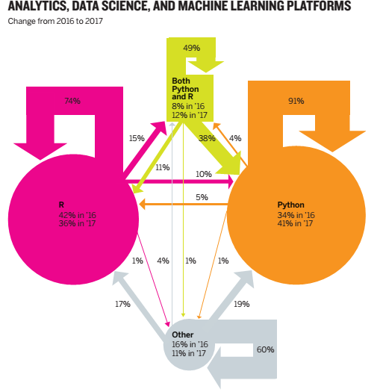

Slide 2
Critique the chart in slide 1. Understanding that it shows the proportion of people using each platform and the proportion of those who switched from one to the other, explain why you think it’s not as effective as it could be. Provide at least three examples.
Sketch at least three alternative approaches to charting this data. Choose whatever context you want to highlight.
Make slides accordingly to present it to an audience approximately 50 people with diverse background (30 – 45 years professionals)
Time of presentation is 8 – 10 minutes

